Slide 1
PLACEMENT MANAGEMENT SYSTEM
By
Name: Monalisa Sahoo
BATCH: 2021-5760
TRAINER: Mrs.Anjana Sarode

Slide 2
PROJECT IDEA
It’s a placement management site of a institution.
It comprises of student record, training and placement related data.
It’s a user friendly and is compatible on different browser.
It allows to add student data, edit and can view companies those were come for recruitment process.

Slide 3
1.INTRODUCTION
Placement is done at various colleges is by human intervention due to which there is a maximum chance of errors.
The major problem is searching and updating of the student data.
Placement Officer has to collect the information of various companies who comes for recruitment & manage the student’s profile and their documents.
Placement officers submit the information of students and if any changes or updates are required in the profile of any student, it has to be done manually.
A profile for each student is created with the necessary credentials for the portal. The system uses MySQL for database management and will sort the data of the student

Slide 4
2. PURPOSE
Placement Management System manages student information in the college with regard to placement.
It has the facility of maintaining the details of the student, thereby reducing the manual work.
It will save time and energy which are spending in making reports and collecting data.
Placement Management System can be accessed throughout the college with proper login provided.

Slide 5
3. PROJECT OBJECTIVE
The main objective of the placement management system is to reduce manual work and time. It is difficult and time-consuming to collect all the details from each student.
To avoid this problem we have planned to develop a web-based. placement management system.
- Easy to find out the list of eligible students attending.
-Saves the time of placement officer and faculties.
-This system makes student information more secure

Slide 6
4. TECHNOLOGY USED
HTML
CSS
JavaScript
Bootstrap

Slide 7
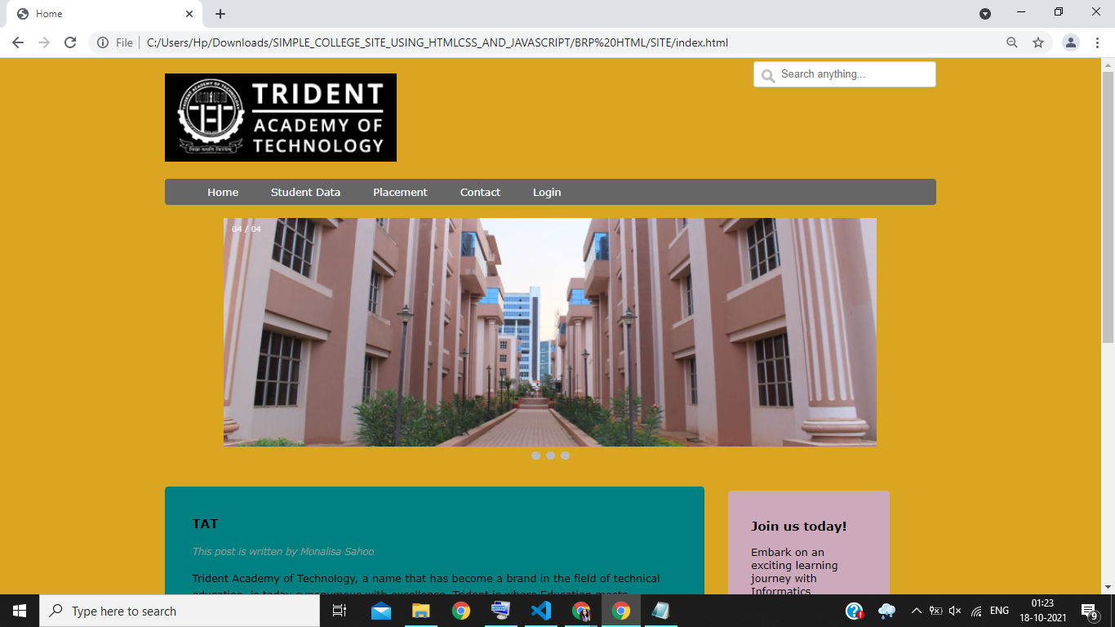
RESULTS
This is the Home page where there is one header.
Here we have student data, placement, contact and login form.

Slide 8
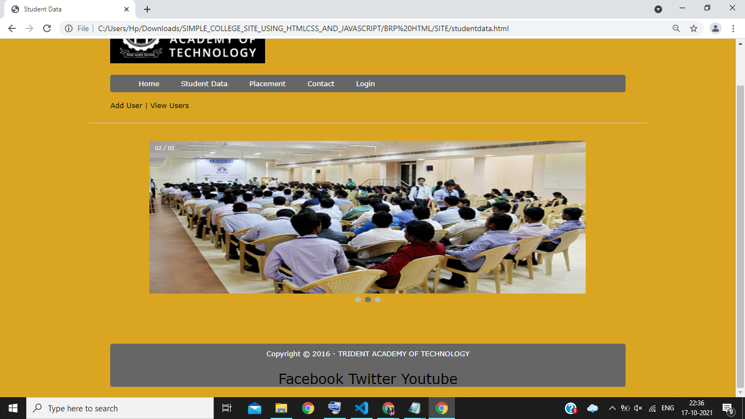
This the student data section.
Here it has two part “Add Users“ and “View Users”

Slide 9
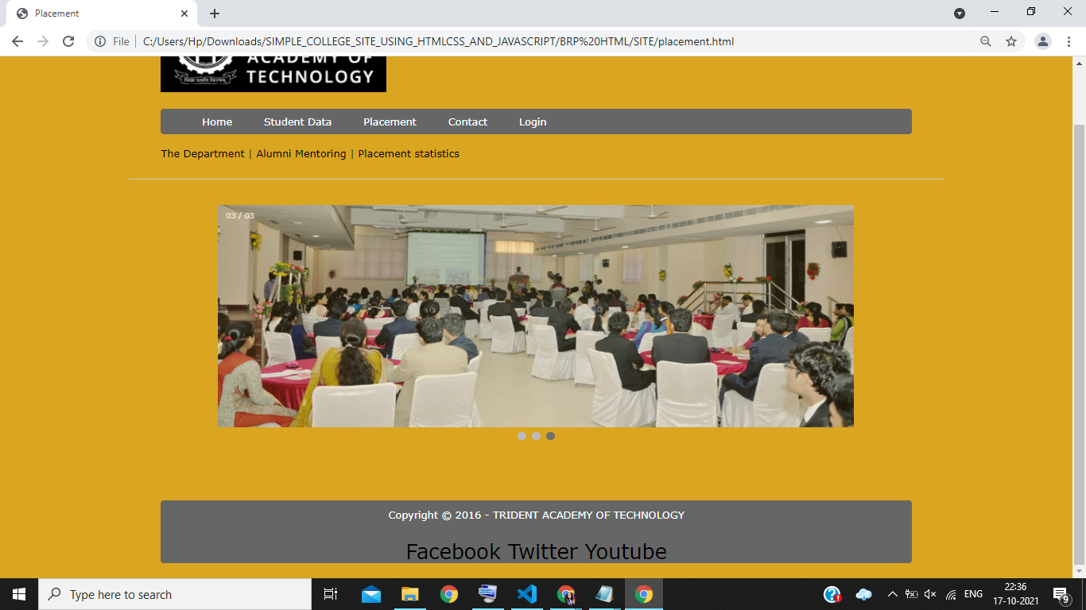
This is Placement Section .
Here there is three more section: The Department, Alumni Mentoring, Placement Statistics.

Slide 10
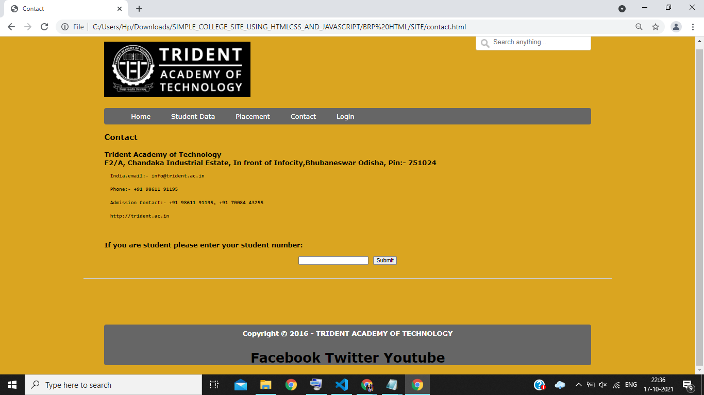
This is the Contact section where you can contact to college regarding any query.

Slide 11
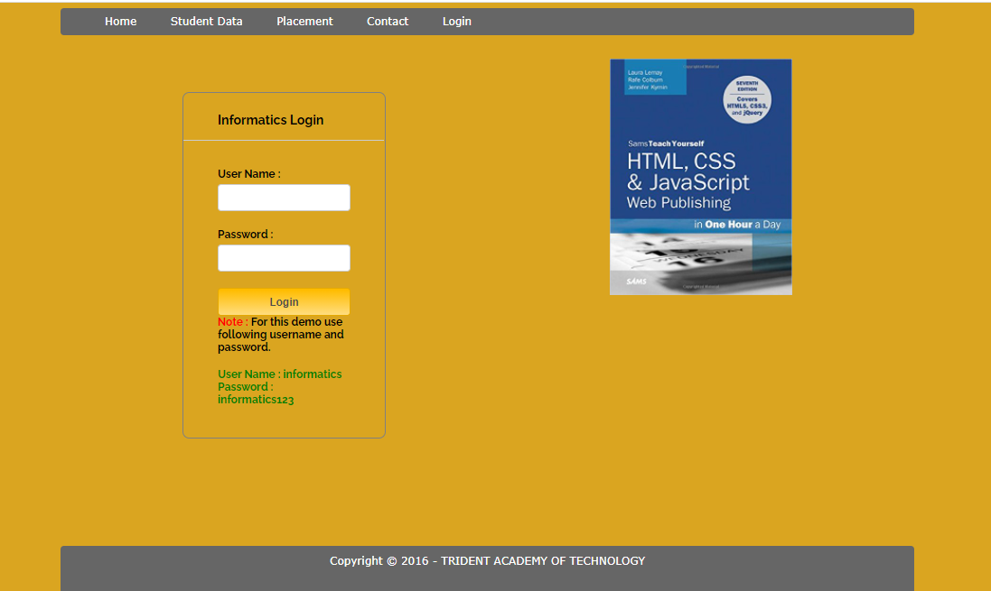

Slide 12
CONCLUSION
In the proposed system, all of these problems become automated. The registration of the student for an upcoming placement, the addition of a new user, notifying students, sharing information, the privacy of the student, etc is all met. The admin validates the information .
As we saw front-end part has completed only, so after completion of the backend part also it will get available for our users.

Slide 13
REFERENCES
https://en.wikipedia.org/wiki/Project_management
https://www.freeprojectz.com/project-report/3049
https://ijisrt.com/assets/upload/files/IJISRT20MAY826.pdf
https://www.creatrixcampus.com/placement-management-software

